Slide 1

Digital Signal Processing: PBL approach
Theme:
Title:
Course: Digital Signal Processing
Course Code: 23EECC303
Semester: V
Credits: 4 [2-0-2]
Hours/Week: 6
Faculty Mentor:
Team Details
Sl.No. | Roll No. | Div | SRN | Name
1 | 415 | D | 01FE23BEC176 | AARYA S
2 | 421 | D | 01FE23BEC182 | ABHISHEK SHYAGAVI
3 | 460 | D | 01FE23BEC225 | VISHWANATH H
4 | 477 | D | 01FE22BEC059 | PRAMOD P

Slide 2
Title:
Content
Problem Statement
Introduction
Literature survey
Functional Block diagram
Data Set/Data Acquisition
Methodology
Digital IIR Filter Design
Digital FIR Filter Design
Conclusion
Results
References

Slide 3
Title:
Problem Statement
GENDER DRIVEN EMOTION RECOGNITION THROUGH SPEECH SIGNALS

Slide 4
Title:
Introduction
Speech is one of the most natural forms of communication between humans and machines.
Gender recognition through speech signals aims to identify whether the speaker is male or female based on voice characteristics.
The project uses Digital Signal Processing (DSP) techniques to analyze features such as pitch, formants, energy, and frequency spectrum.
Male and female voices differ in pitch range, vocal tract length, and frequency components, which help in accurate gender classification.
The main goal is to develop an efficient and reliable model that identifies speaker gender using speech signal analysis

Slide 5
Title:
Literature Survey
Sl.No | Title | Methodology/ Algorithm | Merits | Demerits | Gaps
1 | Bisio, I.; Delfino, A.; Lavagetto, F.; Marchese, M.; Sciarrone, A. (2013) — “Gender-Driven Emotion Recognition Through Speech Signals for Ambient Intelligence” | extract 182 prosodic & spectral features, gender detection by pitch thresholding, then SVM classifier (so HYBRID / ML). | comprehensive feature set; shows performance gain when gender is used as prior. | uses SVM (ML) for final decision — not purely DSP. | the gender detection + feature selection parts are pure DSP
2 | K. S. Rao et al. (2013) “Emotion recognition from speech using global and local prosodic features” | extraction of sentence level prosodic features and analysis across hierarchical levels; evaluation. | detailed multi-level prosodic feature set you can compute with DSP | evaluation uses ML classifiers; decision rules are not the main focus | DSP-only decision module you can design rule-based decision logic.
3 | “Emotion recognition from speech using wavelet packet and spectral features” | wavelet-packet spectral features; classifier evaluation (hybrid). DSP-friendly feature extraction. | lap-level spectral decomposition methods (wavelet packets) that are DSP-implementable; good feature recipes. | uses classifier back-end (ML). | wavelet packet coefficients & energy bands can be used to craft rule thresholds for emotions

Slide 6
Title:
Literature Survey
Sl.No | Title | Methodology/ Algorithm | Merits | Demerits | Gaps
4 | “Basic analysis on prosodic features in emotional speech” (Conference/Journal ~2012) | prosodic analysis comparing genders in emotional speech | raw DSP analysis of gender differences; explicit charts/thresholds suggested. | small dataset / language specific. | can be generalized to rule thresholds and tested across languages
5 | “The role of voice quality and prosodic contour in affective speech” | perceptual and acoustic analysis focusing on voice quality and prosodic contour. | strong focus on voice-quality descriptors) and contour — directly implementable via DSP. | not a recognition system per se; more an analysis paper | provides specific acoustic correlates you can turn into deterministic rules after thresholding

Slide 7
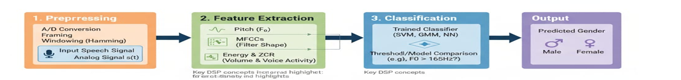
Title:
Functional Block Diagram

Slide 8
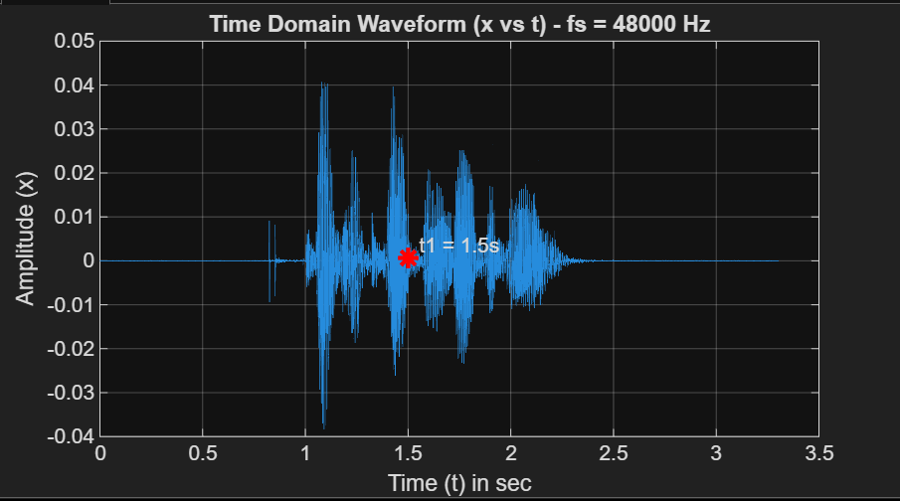
3.3033 s
Title:
3.3033 s
3.3033 s
Data Sets/Data Acquisition
Signal length: 3.3033s
Amplitude range:--1to1
Sampling frequency:48KHz
Frequency range:0-24KHz

Slide 9
Title:
Methodology
Sampling and framing : Audio is sampled at 16 khz and divided into short , stationary frames of 20-40ms
Pitch estimation : Using autocorrelation to detect the fundamental frequency of speech for gender classification
PDF computation : Probability density function of pitch values is used to distinguish between male and female voices
Classification : Using support vector machine to classify emotions based on extracted feature.

Slide 10
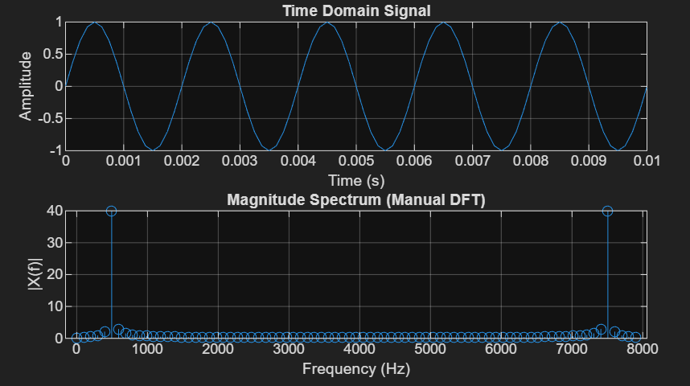
Title:
Discrete Fourier Transform
Time domain sequence
Frequency Spectrum
Number of samples:80
Number of frequency coefficients (N):100Hz
Computation time:0.02s
Execution time:0.03-0.04s

Slide 11
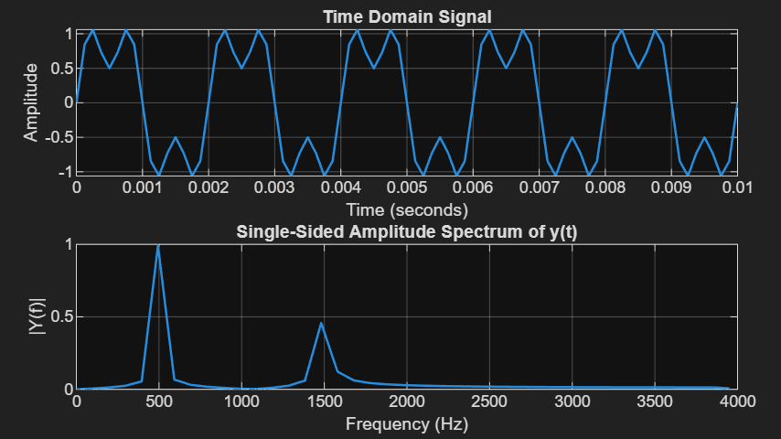
Title:
Fast Fourier Transform
Time domain sequence
Frequency Spectrum
Number of samples:81
Number of frequency coefficients (N):81
Computation time:0.0000768s
Execution time:0.02-0.03s

Slide 12
Title:
Digital Filter Design
Justifications for arriving to the below specifications
Pass band edge frequency:
Stop band edge frequency:
Pass band ripple:
Stop band ripple:
Order of the filter:
Sampling frequency:

Slide 13
Title:
Digital IIR Butterworth Filter Design
Frequency Response of the filter

Slide 14
Title:
Digital IIR Chebyshev Filter Design
Frequency Response of the filter

Slide 15
Title:
Digital FIR Filter Design
Input Signal
Frequency Spectrum of Input
Rectangular window
Frequency Response of the filter
Output Signal
Frequency Spectrum of Output

Slide 16
Title:
Digital FIR Filter Design
Input Signal
Frequency Spectrum of Input
Bartlett window
Frequency Response of the filter
Output Signal
Frequency Spectrum of Output

Slide 17
Title:
Digital FIR Filter Design
Input Signal
Frequency Spectrum of Input
Hanning window
Frequency Response of the filter
Output Signal
Frequency Spectrum of Output

Slide 18
Title:
Digital FIR Filter Design
Input Signal
Frequency Spectrum of Input
Hamming window
Frequency Response of the filter
Output Signal
Frequency Spectrum of Output

Slide 19
Title:
Digital FIR Filter Design
Input Signal
Frequency Spectrum of Input
Blackmann window
Frequency Response of the filter
Output Signal
Frequency Spectrum of Output

Slide 20
Title:
Results
Content Font Size-20 (Calibri (Body))

Slide 21
Title:
References
Content Font Size-16 (Calibri (Body))
Minimum 8 references
Example:
[1] M. T. Kimour and D. Meslati, “Deriving objects from use cases in real-time embedded systems,” Information and Software Technology, vol. 47, p. 533-545, June 2005.

Slide 22
Thank You

